Slide 1
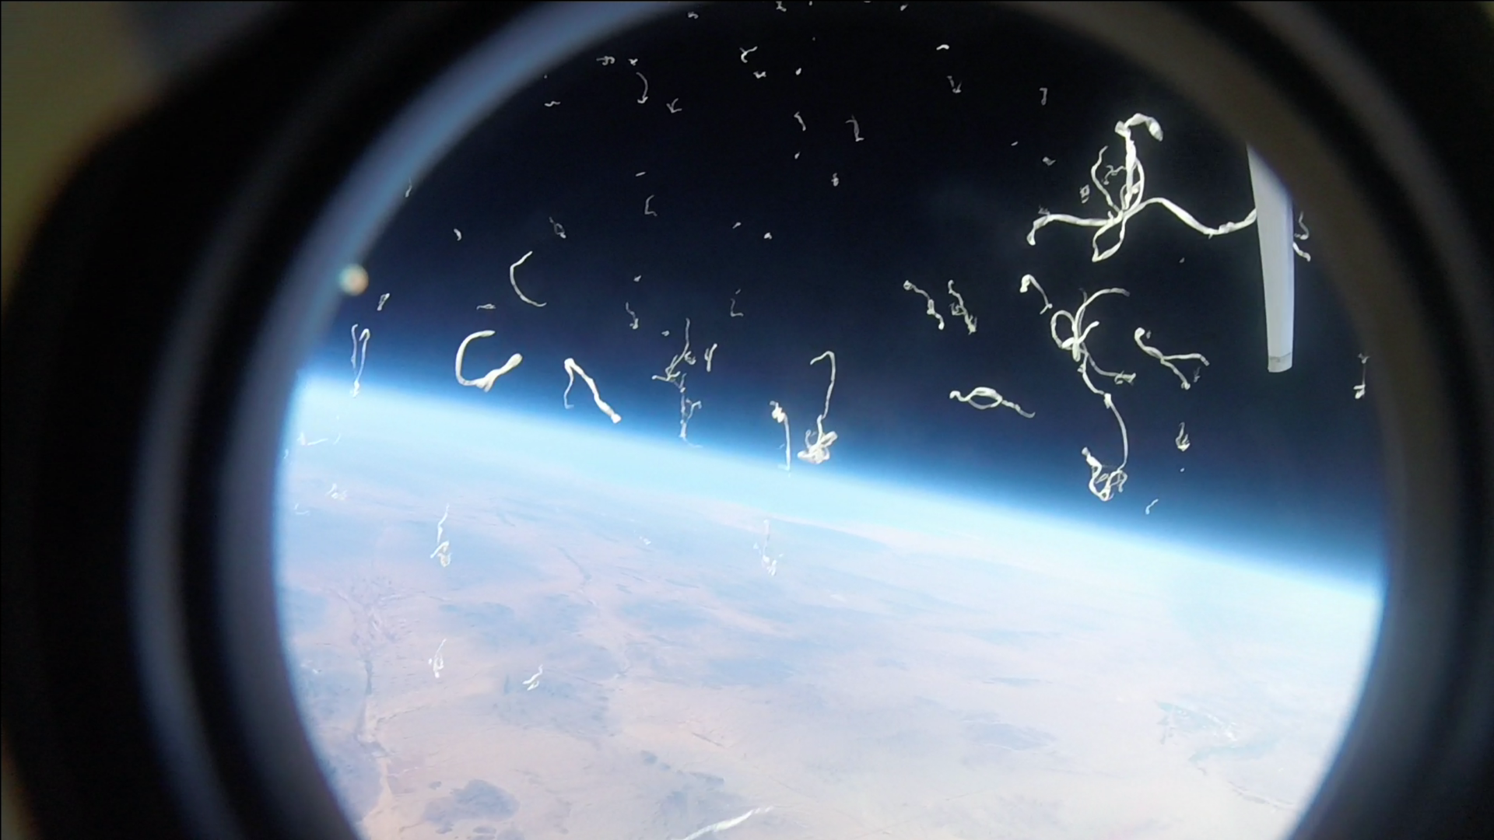
Ascend Balloon Launch ECE294
Team Aether: Rahim Muhammad, Francisco Armenta,
Joel Gordillo, Valerie Galaz, Yulisa Gonzalez

Slide 2
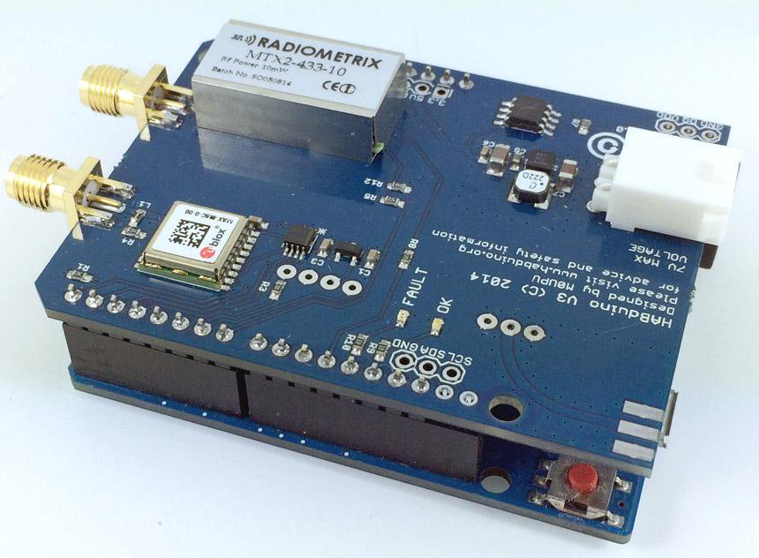
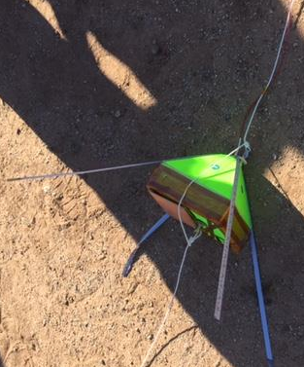
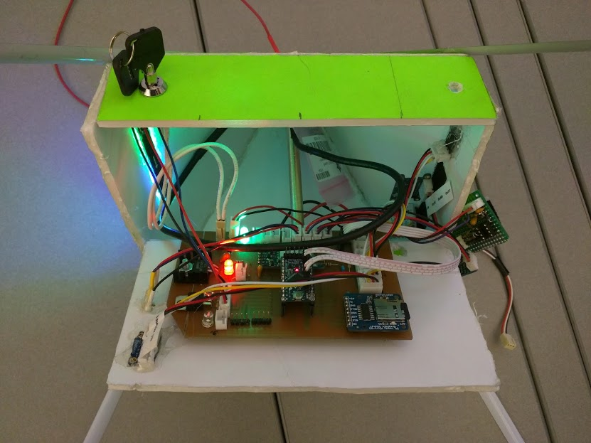
Onboard Sensors
GPS Receiver/HAM Radio Transmitter
Triple-axis Magnetometer
Voltage Gradient
Bluetooth Transmitter
Temp. x 2
Humidity
Pressure
Acceleration
UV x 2
Gyroscope
= Data Received
= No Data

Slide 3

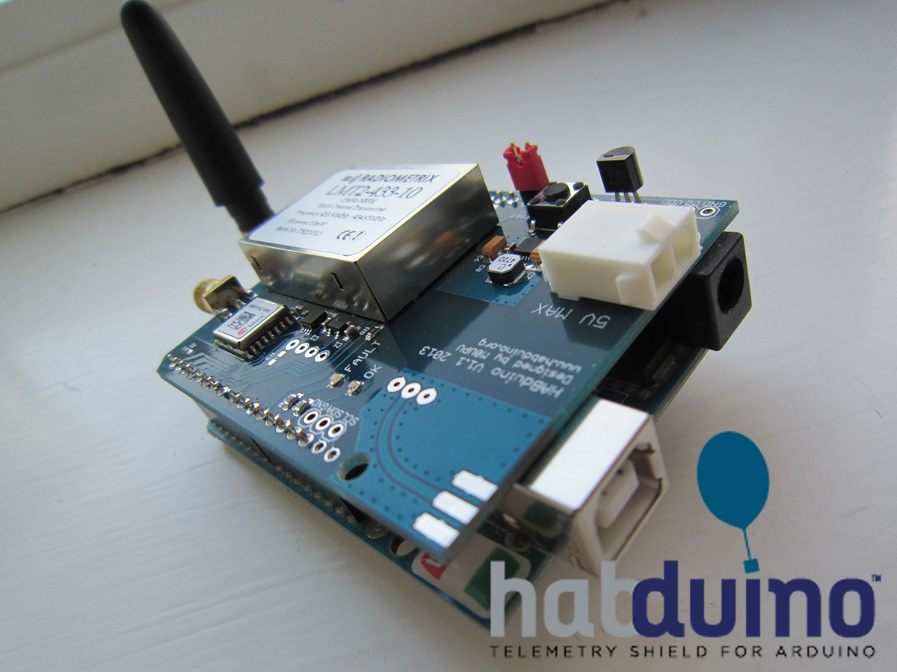
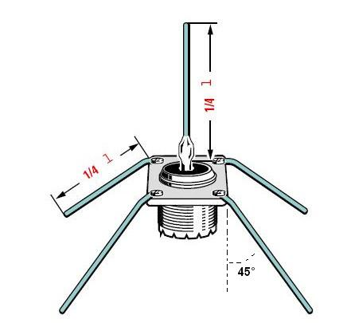
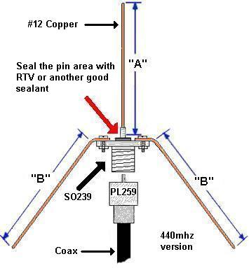
Automatic Packet Reporting System (APRS)

Slide 4
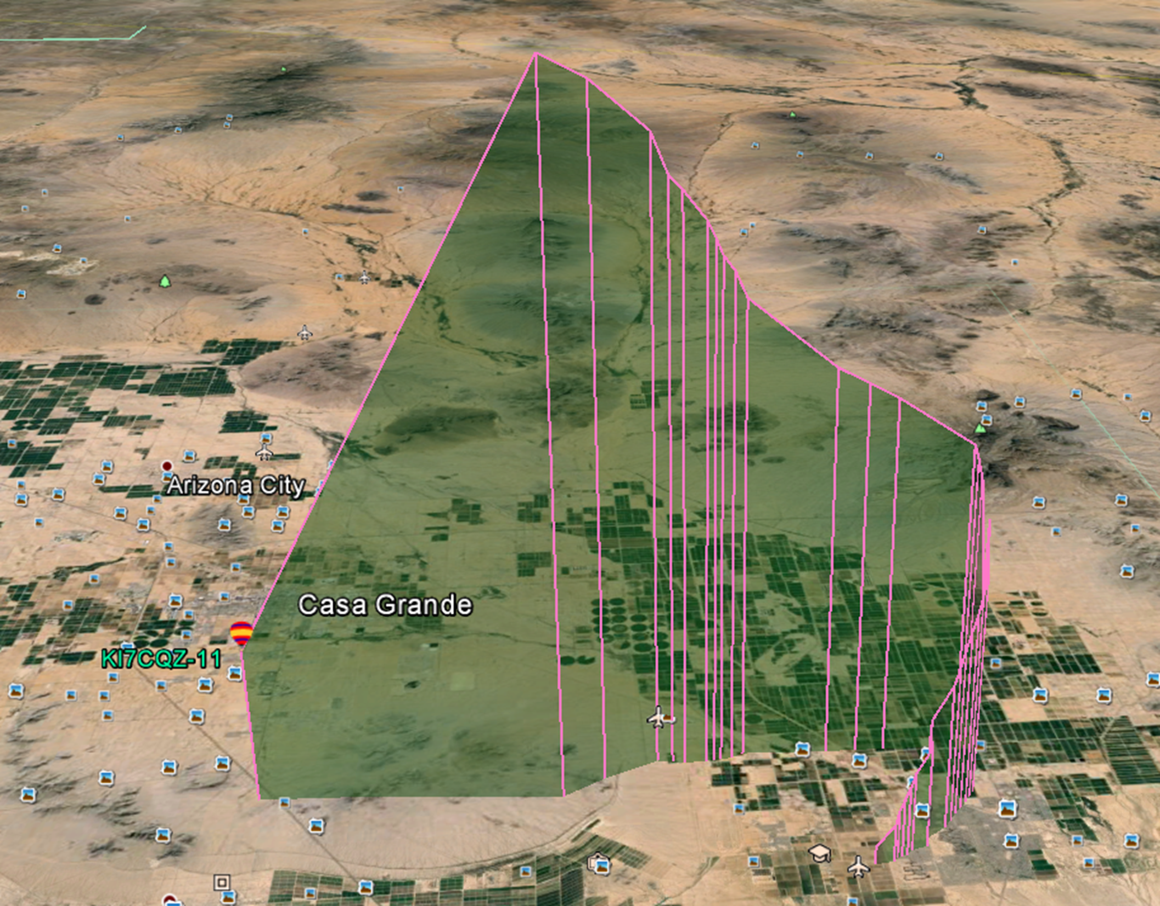
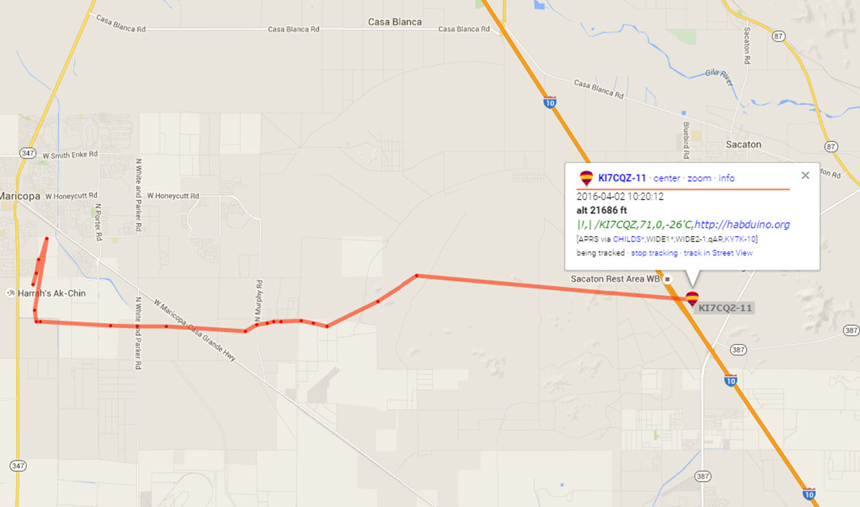
Automatic Packet Reporting System (APRS)
Frequency: 144.390 Mhz
CallSign: KI7CQZ

Slide 5
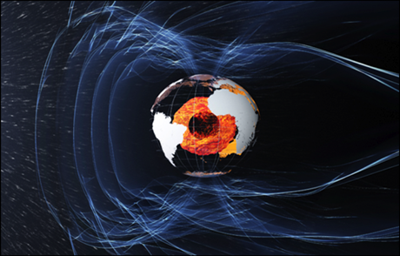
Earth’s Magnetic Field
We wanted to investigate Earth’s Magnetic Field
We needed a sensor that was highly sensitive

Slide 6
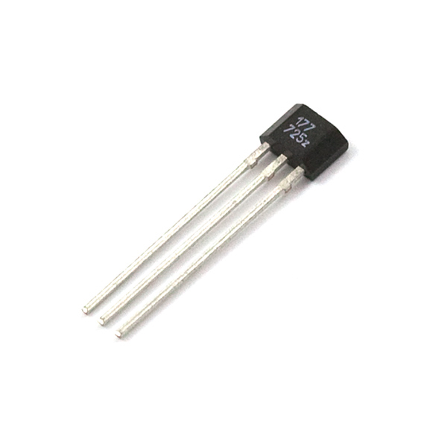
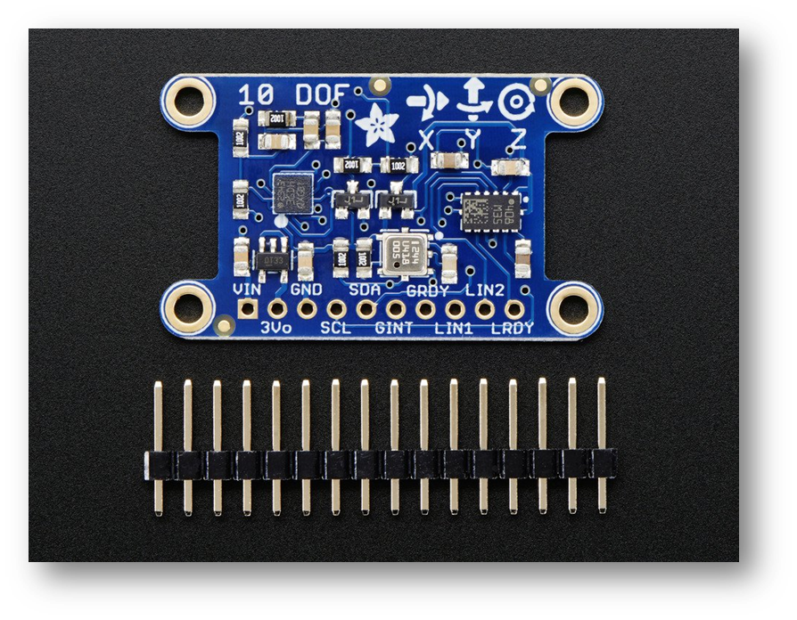
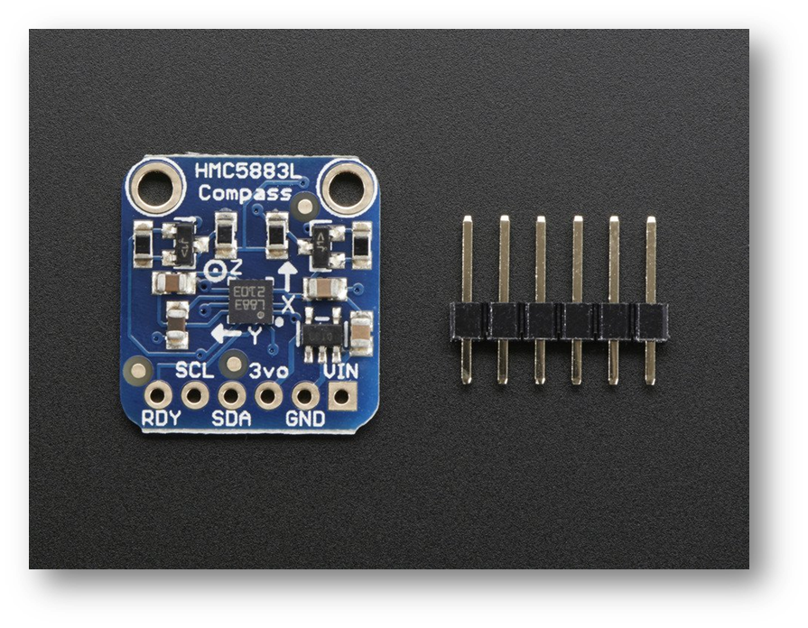
Earth’s Magnetic Field cont.
Hall Effect was not sensitive enough
Next, we investigated Adafruit’s 10 Degrees of Freedom…Also, not sensitive enough
Finally found the one: Adafruit’s HMC5883L

Slide 7
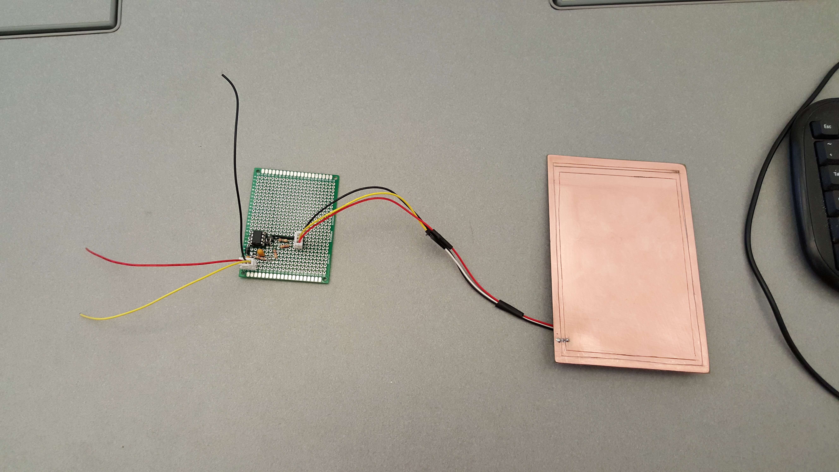
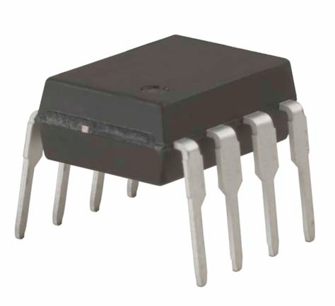
Voltage Gradient
Conductor plate
Guard Ring
Ground
Link: http://tinyurl.com/h9bqwzc
Notes:
Collects variations in charge in the atmosphere, as electrons hit the conductive plate , the voltage rises and vise versa

Slide 8
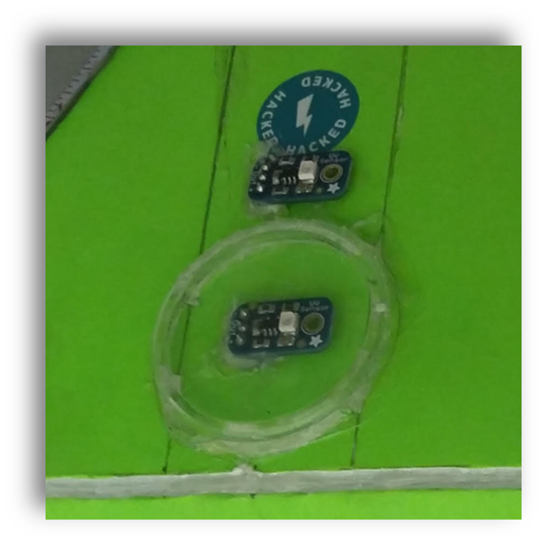
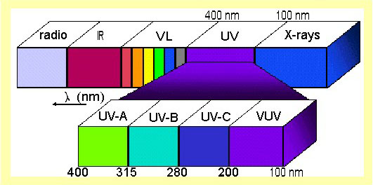
UV Sensor
No Data Collected
2 UV sensors used so that we can measure both UV A+B and also just B.

Slide 9
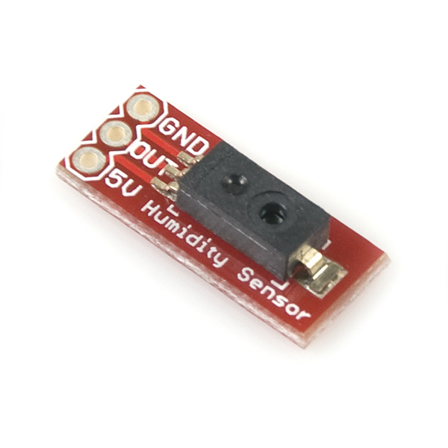
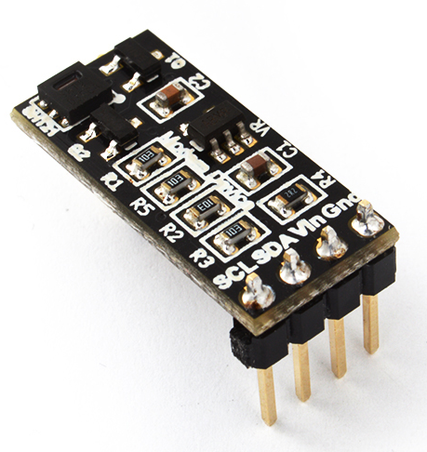
HUMIDITY & TEMPERATURE
Data Not Collected
Sparkfun Humidity Sensor Breakout ​ - Rejected
Modern Device SHT21 Humidity & Temperature​ - Accepted
The Goal was to gather relative humidity data at known temperatures and locations.

Slide 10
Questions
Comments
Thank You!!!

